Slide 1

Group Project
by RAGAVI T
RAKSHANA PON
RANJANI V
RANJITHA R

Slide 2
ObjectivE
The objective of the weather forecasting project is to develop a system that improves the accuracy of weather predictions using data analysis and machine learning. The system will provide real-time updates by integrating data from sources like satellites and sensors, helping individuals and organizations make informed decisions. It will also offer user-friendly platforms for easy access to weather information, contributing to public safety and better preparedness for extreme weather events.

Slide 3
WEATHER
FORCASTING

Slide 4


WEEK-1 BRAIN STORMING

Slide 5
keywords
1.weather 2.forecasting 3.temperature 4.rainfall 5.humidity 6.windspeed 7.storm 8.thunderstorm
9.cloud cover 10.precipitation 11.visibility 12.weather map 13.satelite data 14.meteorlogy 15.climate change 16.weather patterns

Slide 6
keywords
17.seasonal forcast 18.real-time data 19.weather stations 20.predictive models 21.radar
22.doppler radar 23.severe weather 24.tornado
25.hurricane 26.snowfall 27.uv index 28.heatwave 29.cold front 30.warm front
31.barometric pressure 32.dew point

Slide 7
keywords
33.weather alerts 34.air quality 35.weather app 36.temperature trends 37.weather analysis 38.weather API 39.weather forecasting 40.weather pattern

Slide 8
SORTING AND AFFINITY LINK

Slide 9
weather events:
core weather elements:
temperature
rainfall humidity wind speed dew point
atmosphereic
pressure
precipitation visibility cloud cover
storm
thundersotm tornado hurricane
heatwave
cold front warm front snowfall

Slide 10
WEEK 2 ACTIVITY
MIND - MAPPING

Slide 11
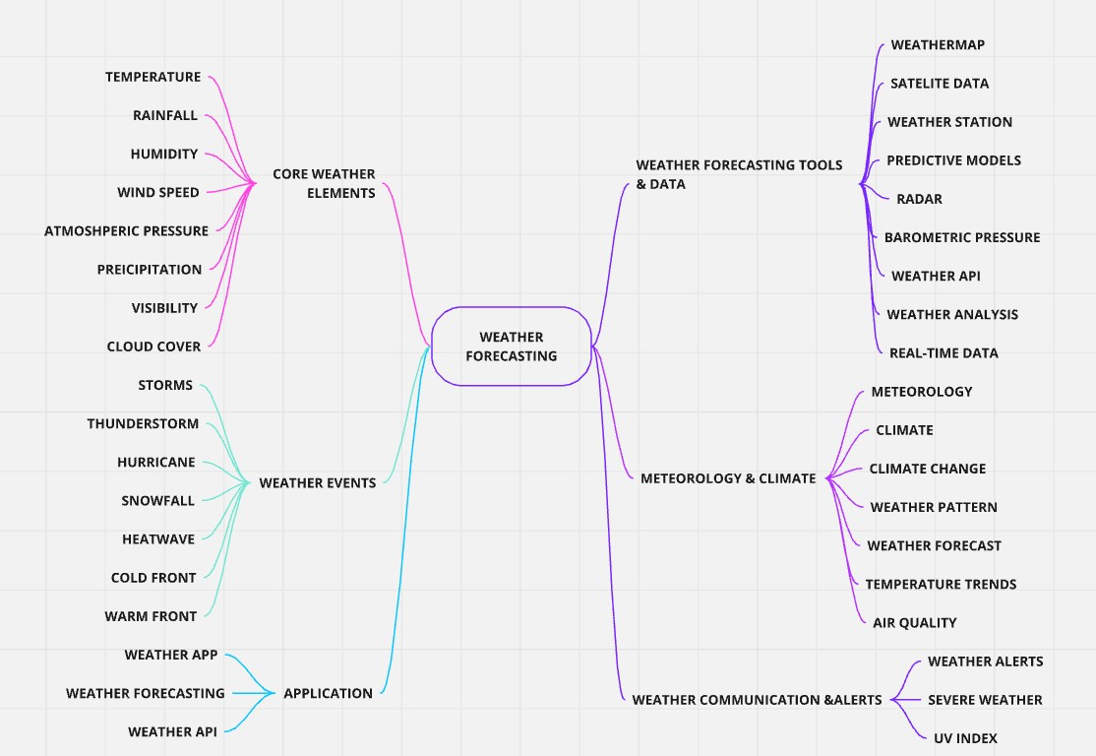

Slide 12
WEEK 3 ACTIVITY
5Ws+1H MATRIX TABLE

Slide 13
Group
Who
What
Where
When
Why
How
Core Weather Elements
Meteorologists, Weather analysts
Measure weather elements like temperature, humidity, etc.
Global, Regional, Local
Continuous, Real-time, Seasonal
To understand the current weather conditions
Using weather stations, satellite data, sensors
Weather Events
Emergency
services, Public, Meteorologists
Observe and predict events like storms, tornadoes, etc.
Regions prone to severe weather events
During specific weather conditions
To prepare and warn people about potential hazards
Using predictive models, real-time data
Weather
Forecasting Tools & Data
Meteorologists,
Data scientists
Collect, analyze, and predict weather patterns
Weather stations, satellites, laboratories
Continuous, Real-time
To provide accurate and timely weather forecasts
Through satellite data, radars, weather models
Meteorology & Climate
Meteorologists, Climate scientists
Study long-term weather patterns and climate
Global, Regional
Over decades, centuries
To understand climate trends and impacts
Analyzing historical
data, climate models
Communicate weather conditions and warnings
TV, Radio, Mobile apps, Online platforms
Using weather
alerts systems,
media broadcasts
Weather Communication & Alerts
Governments, Media, Public
Before and during severe weather events
To inform and protect the public
Applications
App developers, Weather services, Public
Develop and use weather apps and APIs
On digital platforms, mobile devices
Daily, especially during weather changes
To provide easy access to weather information
Developing apps, integrating weather
APIs

Slide 14
WEEK 4
USER PARTICIPANT
MAPPING

Slide 15

disaster
management
energy engineers
tilots
outdoor event planners
renewable
marine
meteorologists
construction
retail
employees
workers
weather forcasting
primary level secondary level
teritiary level
quaterniary level
truck drivers
conultants
office
delivery
emergenc
workers
drivers
fisherman
y
farmers
health care
students
environmental
responders
travel
guides
researchers

Slide 16
WEEK 5 ACTIVITY
CONTEXTUAL INQUIRY

Slide 17
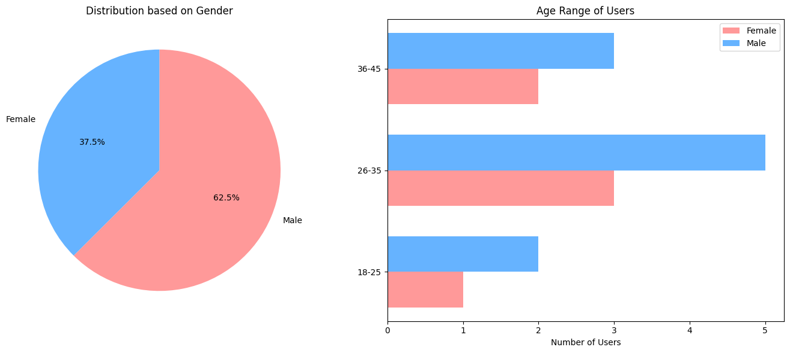

Slide 18
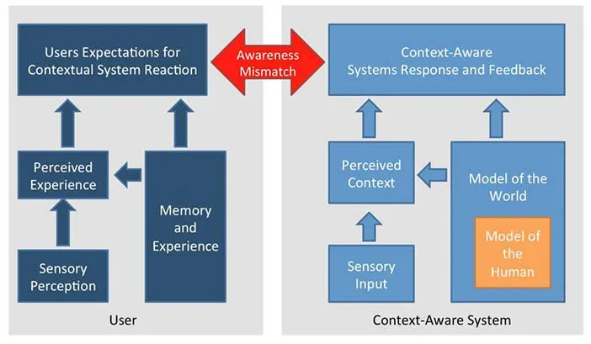
concepTUal

Slide 19
WEEK 6 ACTIVITY
QUESTIONARIES AND CUE CARDS

Slide 20
Open-ended Questions:QUESTIONARIES
What features do you find most useful in a weather forecasting app? How do you currently check the weather forecast and why?
Close-ended Questions:
Do you use a weather forecasting app daily? Yes
No
Do you rely on weather forecasts for long-term planning (beyond a week)? Yes
No
Dichotomous Questions:
Do you prefer visual weather reports (like maps) over text-based information? Yes
No
Does the app need to provide hourly weather updates for you to find it useful? Yes
No

Slide 21
Multiple Choice Questions:
What is the primary reason you use a weather forecasting app?
To check daily weather
To plan for upcoming events To receive weather alerts For travel planning
Scaling Questions:
1. On a scale of 1-5, how satisfied are you with your current weather app?
(1 being least satisfied, 5 being most satisfied)

Slide 22
CUE CARDS
User Behavior
What are the most common ways users interact with the weather forecasting system?
How frequently do users check the weather updates?
Does it differ by user type (e.g., casual users vs. professionals)?
System Features
How does the system ensure real-time weather data is accurate and up-to-date?
What predictive models does the system use to generate weather forecasts?
Decision Making
How do farmers use the weather forecasts to make decisions about planting and irrigation?
What factors do event planners consider when relying on weather forecasts for outdoor events?

Slide 23
CUE CARDS
4. Future Iimprovements
How can the accuracy of weather forecasts be improved in the future?
What features can be added to help users better understand complex
weather patterns?

Slide 24
WEEK 7 ACTIVITY
MAPPING

Slide 25
Day 1
Day 2-3
Data Collection
Data Processing
Day 4
Model Generation
Day 5
Severe Weather Detection
Day 6
Alerts & Notifications
Day 7
Review & Optimization

Slide 26
WEEK 8 ACTIVITY
PERSONA’s AND
OIOR TABLE

Slide 27
Name: David Thompson Role: Outdoor Event Planner Age: 40
Background: David plans large outdoor events and needs to know precise
weather conditions well in advance. His decisions about location setup, guest
safety, and event schedule are all heavily impacted by the weather.
Needs: Long-term weather forecasts, severe weather alerts, mobile-friendly notifications, and suggestions for backup plans based on forecasted weather
changes.
Frustrations: Inconsistent long-term forecasts, vague weather predictions, and not receiving timely updates about forecast changes.

Slide 28
Objective
Provide Accurate Weather Forecasts
Enable Real-Time Severe Weather Alerts
Deliver Customized Forecasts
Support Data-Driven Decision Making
Ensure User-Friendly Access to Data
Inputs
- Historical weather data - Real-time satellite and sensor data - Atmospheric models
- Meteorological sensor data - Early warning signs (temperature, pressure changes)
- User location - User preferences (commute, event planning)
- Agricultural weather data (rainfall, temperature, humidity) - Historical crop yield data
- Weather data APIs - User interface design considerations
Outputs
- Hourly and daily weather predictions - Weather alerts
- Real-time alerts for severe weather - Push notifications
- Personalized forecasts - Recommendations for outdoor activities
- Detailed farming forecasts
- Irrigation and harvest advice
- Mobile-friendly weather apps
- Website with real-time updates
Requirements
- Access to reliable real-time data sources - Implement machine learning algorithms for weather pattern recognition and prediction
- Integration with mobile networks - Real-time data processing - User notification system for rapid alerts
- User account and location tracking system - Customizable settings for different forecast formats (e.g., hourly, weekly)
- Integration with agricultural databases - Predictive models specific to farming regions and types of crops
- Cross-platform support (web, iOS, Android) - Intuitive UI/UX design - Fast loading times and low data consumption for areas with poor signal

Slide 29
THANK YOU

